Slide 1
UNIT - II
DIVIDE AND CONQUER
&
GREEDY METHOD

Slide 2
Divide and Conquer
The most well known algorithm design strategy:
Divide instance of problem into two or more smaller instances
Solve smaller instances recursively
Obtain solution to original (larger) instance by combining these solutions

Slide 3
Divide-and-conquer technique
a problem of size n
subproblem 1
of size n/2
subproblem 2
of size n/2
a solution to
subproblem 1
a solution to
subproblem 2
a solution to
the original problem

Slide 4
Divide and Conquer Examples
Sorting: mergesort and quicksort
Tree traversals
Binary search
Matrix multiplication-Strassen’s algorithm
Convex hull-QuickHull algorithm

Slide 5
General Divide and Conquer recurrence: Master Theorem
T(n) = aT(n/b) + f (n) where f (n) € Θ(n^{d})
a < b^{d} T(n) € Θ(n^{d})
a = b^{d} T(n) € Θ(n^{d} lg n )
a > b^{d} T(n) € Θ(n^{log b a})
Note: the same results hold with O instead of Θ.
Notes:
This is the same slide from chapter 2 (analysis of recursive algorithms)
It is a good idea to remind students at this point and do some examples especially
if you went over this quickly and did not do examples the previous time.
Here are examples from before:
T(n) = T(n/2) + 1
T(n) = 2T(n/2) + n
T(n) = 3 T(n/2) + n
=> this last example is important to mention at some point:
Θ(n^{log}₂³)
NB: cannot “eliminate” or simplify this constant

Slide 6
Mergesort
Algorithm:
Split array A[1..n] in two and make copies of each half
in arrays B[1.. n/2 ] and C[1.. n/2 ]
Sort arrays B and C
Merge sorted arrays B and C into array A as follows:
  Repeat the following until no elements remain in one of the arrays:
    compare the first elements in the remaining unprocessed portions of the arrays
    copy the smaller of the two into A, while incrementing the index indicating the unprocessed portion of that array
  Once all elements in one of the arrays are processed, copy the remaining unprocessed elements from the other array into A.

Slide 7
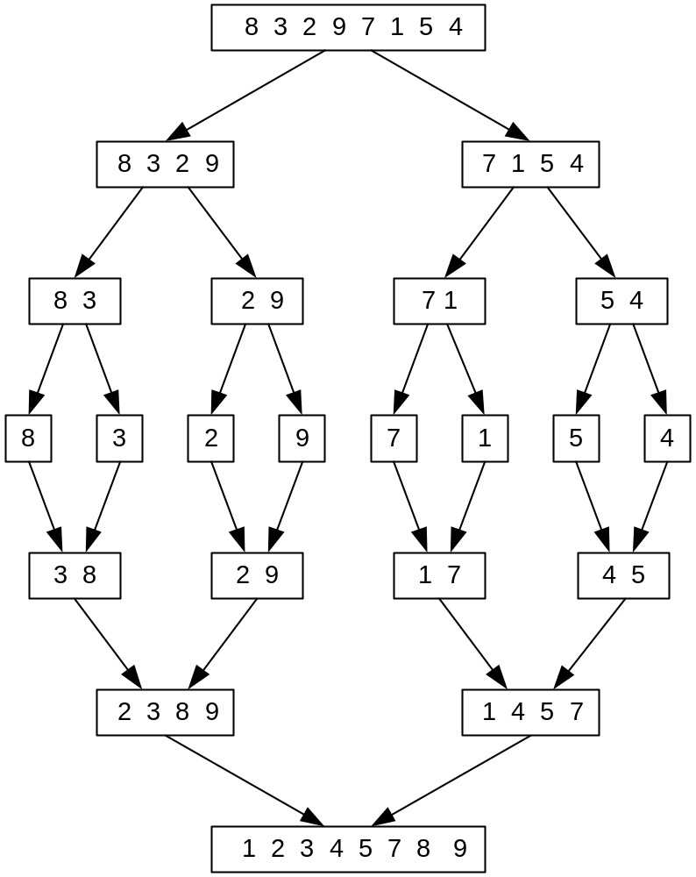
Mergesort Example

Slide 8
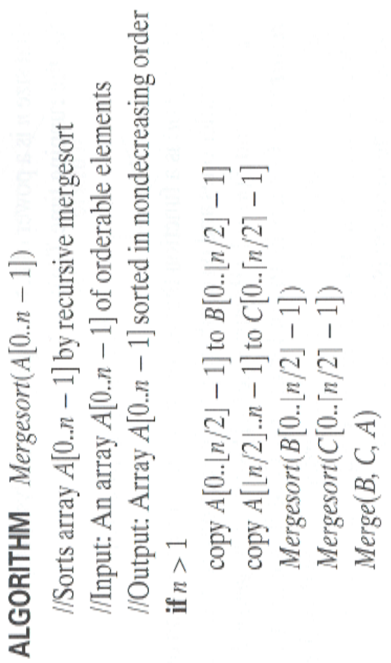
Pseudocode for Mergesort
ALGORITHM Mergesort(A[0..n-1])
//Sorts array A[0..n-1] by recursive mergesort
// Input: An array A[0..n-1] of orderable elements
// Output: Array A[0..n-1] sorted in non-increasing order
If n>1
copy A[0..[n/2]-1] to B[0..[n/2]-1]
copy A[[n/2]..n-1] to C[0..[n/2]-1]
Mergesort(B[0..[n/2]-1])
Mergesort(C[0..[n/2]-1])
Merge(B,C,A)
Notes:
Go over this example in detail, then do another example of merging, something like:
(1 2 5 7 9)
(3 4 6)

Slide 9
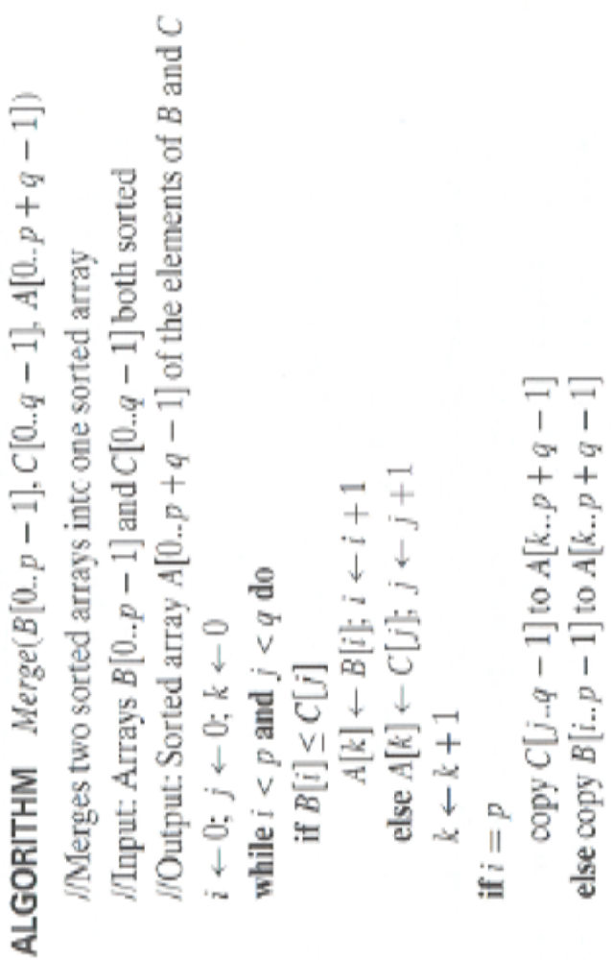
Pseudocode for Merge
ALGORITHM Merge (B[0..p-1], C[0..q-1], A[0..p+q-1]
// Merges two sorted arrays into one sorted array
// Input: Arrays B[0..p-1] and C[0..q-1] both sorted
// Output: Sorted array A[0..p+q-1] of the elements of B and C
i ← 0; j← 0; k←0
While i<p and j<q do
if B[i]<=C[j]
A[k] ← B[i]; i ← i+1
else A[k] ← C[j]; j ← j+1
k ← k+1
If i=p
copy C[j..q-1] to A[k..p+q-1]
Else
copy B[i..p-1] to A[k..p+q-1]

Slide 10
Recurrence Relation for Mergesort
Let T(n) be worst case time on a sequence of n keys
If n = 1, then T(n) = Θ(1) (constant)
If n > 1, then T(n) = 2 T(n/2) + Θ(n)
  two subproblems of size n/2 each that are solved recursively
  Θ(n) time to do the merge

Slide 11
Efficiency of mergesort
All cases have same efficiency: Θ( n log n)
Number of comparisons is close to theoretical minimum for comparison-based sorting:
  log n ! ≈ n lg n - 1.44 n
Space requirement: Θ( n ) (NOT in-place)
Can be implemented without recursion (bottom-up)
Notes:
even if not analyzing in detail, show the recurrence for mergesort in worst case:
T(n) = 2 T(n/2) + (n-1)
worst case comparisons for merge

Slide 12
Quick-Sort
Quick-sort is a randomized sorting algorithm based on the divide-and-conquer paradigm:
Divide: pick a random element x (called pivot) and partition S into
  L elements less than x
  E elements equal x
  G elements greater than x
Recur: sort L and G
Conquer: join L, E and G
x
x
L
G
E
x

Slide 13
Quicksort
Select a pivot (partitioning element)
Rearrange the list so that all the elements in the positions before the pivot are smaller than or equal to the pivot and those after the pivot are larger than the pivot
Exchange the pivot with the last element in the first (i.e., ≤ sublist) – the pivot is now in its final position
Sort the two sublists
p
A[i]≤p
A[i]>p

Slide 14
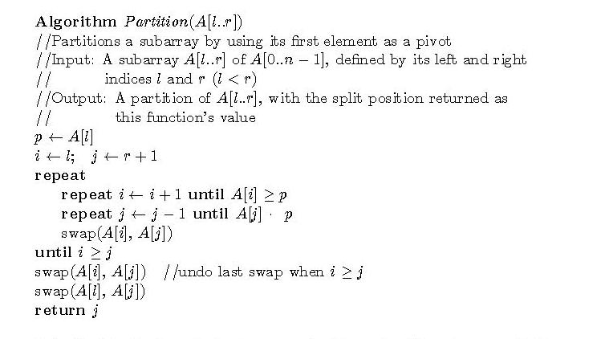
The partition algorithm

Slide 15
Efficiency of quicksort
Best case: split in the middle — Θ( n log n)
Worst case: sorted array! — Θ( n²)
Average case: random arrays — Θ( n log n)
Improvements:
  better pivot selection: median of three partitioning avoids worst case in sorted files
  switch to insertion sort on small subfiles
Considered the method of choice for internal sorting for large files (n ≥ 10000)

Slide 16
Binary Search - an Iterative Algorithm
Very efficient algorithm for searching in sorted array:
K vs A[0] . . . A[m] . . . A[n-1]
If K = A[m], stop (successful search);
otherwise, continue searching by the same method
in A[0..m-1] if K < A[m]
and in A[m+1..n-1] if K > A[m]

Slide 17
Pseudocode for Binary Search
ALGORITHM BinarySearch(A[0..n-1], K)
l ← 0; r ← n-1
while l ≤ r do // l and r crosses over→ can’t find K
m ← ⎣(l+r)/2⎦
if K = A[m] return m //the key is found
else if K < A[m] r ← m-1 //the key is on the left half of
the array
else l ← m+1 // the key is on the right half of the array
return -1

Slide 18
Binary Search – a Recursive Algorithm
ALGORITHM BinarySearchRecur(A[0..n-1], l, r, K)
if l > r
return –1
else
m ← ⎣(l + r) / 2⎦
if K = A[m]
return m
else if K < A[m]
return BinarySearchRecur(A[0..n-1], l, m-1, K)
else
return BinarySearchRecur(A[0..n-1], m+1, r, K)

Slide 19
Analysis of Binary Search
Worst-case (successful or fail) :
  C_{w} (n) = 1 + C_{w}( ⎣n/2⎦ ),
  C_{w} (1) = 1
  solution: C_{w}(n) = ⎣ log₂ n⎦ +1 = ⎡log₂(n+1)⎤
This is VERY fast: e.g., C_{w}(10⁶) = 20
Best-case: successful C_{b} (n) = 1,
fail C_{b} (n) = ⎣ log₂ n⎦ +1
Average-case: successful C_{avg}(n) = log₂ n – 1
        fail C_{avg}(n) = log₂(n+1)

Slide 20
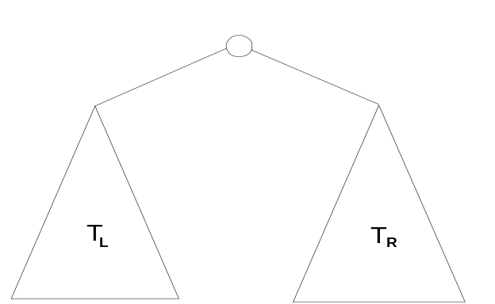
Binary Tree Traversals
Definitions
  A binary tree T is defined as a finite set of nodes that is either empty or consists of a root and two disjoint binary trees T_{L} and T_{R} called, respectively, the left and right subtree of the root.
  The height of a tree is defined as the length of the longest path from the root to a leaf.
Problem: find the height of a binary tree.

Slide 21
Pseudocode - Height of a Binary Tree
ALGORITHM Height(T)
//Computes recursively the height of a binary tree
//Input: A binary tree T
//Output: The height of T
if T = ∅
return –1
else
return max{Height(T_{L}), Height(T_{R})} + 1

Slide 22
Analysis:
Number of comparisons of a tree T with ∅: 2n + 1
Number of comparisons made to compute height is the same as number of additions:
A(n(T)) = A(n(T_{L})) + A(n(T_{R})) +1 for n>0,
A(0) = 0
The solution is A(n) = n

Slide 23
Binary Tree Traversals– preorder, inorder, and postorder traversal
Binary tee traversal: visit all nodes of a binary tree recursively.
Algorithm Preorder(T)
//Implement the preorder traversal of a binary tree
//Input: Binary tree T (with labeled vertices)
//Output: Node labels listed in preorder
if T ‡ ∅
write label of T’s root
Preorder(T_{L})
Preorder(T_{R})

Slide 24
Multiplication of Large Integers
Consider the problem of multiplying two (large) n-digit integers represented by arrays of their digits such as:
A = 12345678901357986429 B = 87654321284820912836
The grade-school algorithm:
a₁ a₂ … a_{n}
b₁ b₂ … b_{n}
(d₁₀) d₁₁d₁₂ … d_{1n}
(d₂₀) d₂₁d₂₂ … d_{2n}
… … … … … … …
(d_{n0}) d_{n1}d_{n2} … d_{nn}
Efficiency: n² one-digit multiplications

Slide 25
First Divide-and-Conquer Algorithm
A small example: A ∗ B where A = 2135 and B = 4014
A = (21·10² + 35), B = (40 ·10² + 14)
So, A ∗ B = (21 ·10² + 35) ∗ (40 ·10² + 14)
= 21 ∗ 40 ·10⁴ + (21 ∗ 14 + 35 ∗ 40) ·10² + 35 ∗ 14
In general, if A = A₁A₂ and B = B₁B₂ (where A and B are n-digit,
A₁, A₂, B₁, B₂ are n/2-digit numbers),
A ∗ B = A₁ ∗ B₁·10^{n} + (A₁ ∗ B₂ + A₂ ∗ B₁) ·10^{n/2} + A₂ ∗ B₂
Recurrence for the number of one-digit multiplications M(n):
M(n) = 4M(n/2), M(1) = 1
Solution: M(n) = n²

Slide 26
Second Divide-and-Conquer Algorithm
A ∗ B = A₁ ∗ B₁·10^{n} + (A₁ ∗ B₂ + A₂ ∗ B₁) ·10^{n/2} + A₂ ∗ B₂
The idea is to decrease the number of multiplications from 4 to 3:
(A₁ + A₂ ) ∗ (B₁ + B₂ ) = A₁ ∗ B₁ + (A₁ ∗ B₂ + A₂ ∗ B₁) + A₂ ∗ B_{2,}
I.e., (A₁ ∗ B₂ + A₂ ∗ B₁) = (A₁ + A₂ ) ∗ (B₁ + B₂ ) - A₁ ∗ B₁ - A₂ ∗ B_{2,}
which requires only 3 multiplications at the expense of (4-1) extra add/sub.
Recurrence for the number of multiplications M(n):
M(n) = 3M(n/2), M(1) = 1
Solution: M(n) = 3^{log 2n} = n^{log 23} ≈ n^{1.585}

Slide 27
Strassen’s matrix multiplication
Strassen observed [1969] that the product of two matrices can be computed as follows:
    C₀₀ C₀₁ A₀₀ A₀₁ B₀₀ B₀₁
    = *
    C₁₀ C₁₁ A₁₀ A₁₁ B₁₀ B₁₁
    M₁ + M₄ - M₅ + M₇ M₃ + M₅
    =
    M₂ + M₄ M₁ + M₃ - M₂ + M₆

Slide 28
Submatrices:
M₁ = (A₀₀ + A₁₁) * (B₀₀ + B₁₁)
M₂ = (A₁₀ + A₁₁) * B₀₀
M₃ = A₀₀ * (B₀₁ - B₁₁)
M₄ = A₁₁ * (B₁₀ - B₀₀)
M₅ = (A₀₀ + A₀₁) * B₁₁
M₆ = (A₁₀ - A₀₀) * (B₀₀ + B₀₁)
M₇ = (A₀₁ - A₁₁) * (B₁₀ + B₁₁)

Slide 29
Efficiency of Strassen’s algorithm
If n is not a power of 2, matrices can be padded with zeros
Number of multiplications: 7
Number of additions: 18

Slide 30
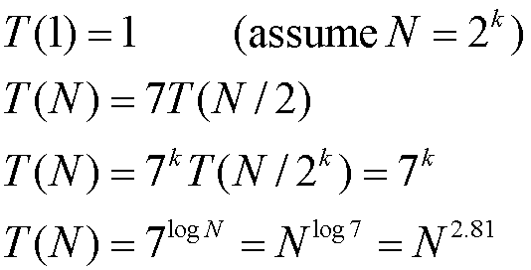
Time Analysis

Slide 31
Standard vs Strassen
 | N | Multiplications | Additions
Standard alg. | 100 | 1,000,000 | 990,000
Strassen’s alg. | 100 | 411,822 | 2,470,334
Standard alg. | 1000 | 1,000,000,000 | 999,000,000
Strassen’s alg. | 1000 | 264,280,285 | 1,579,681,709
Standard alg. | 10,000 | 10¹² | 9.99*10¹¹
Strassen’s alg. | 10,000 | 0.169*10¹² | 10¹²

Slide 32
Greedy Technique

Slide 33
Greedy Technique
Constructs a solution to an optimization problem piece by
piece through a sequence of choices that are:
feasible, i.e. satisfying the constraints
locally optimal (with respect to some neighborhood definition)
greedy (in terms of some measure), and irrevocable
For some problems,
it yields a globally optimal solution for every instance.
For most, does not but can be useful for fast approximations.
Defined by an objective function and a set of constraints

Slide 34
Applications of the Greedy Strategy
Optimal solutions:
  change making for “normal” coin denominations
  minimum spanning tree (MST)
  single-source shortest paths
  simple scheduling problems
  Huffman codes
Approximations/heuristics:
  traveling salesman problem (TSP)
  knapsack problem
  other combinatorial optimization problems

Slide 35
Change-Making Problem
Given unlimited amounts of coins of denominations d₁ > … > d_{m} ,
give change for amount n with the least number of coins
Example: d₁ = 25c, d₂ =10c, d₃ = 5c, d₄ = 1c and n = 48c
Greedy solution:
Greedy solution is
optimal for any amount and “normal’’ set of denominations
may not be optimal for arbitrary coin denominations
Q: What are the objective function and constraints?
<1, 2, 0, 3>
For example, d1 = 25c, d2 = 10c, d3 = 1c, and n = 30c

Slide 36
Minimum Spanning Tree (MST)
Spanning tree of a connected graph G: a connected acyclic subgraph of G that includes all of G’s vertices
Minimum spanning tree of a weighted, connected graph G: a spanning tree of G of the minimum total weight
Example:
6
c
6
c
c
a
a
a
4
1
4
1
1
2
2
d
d
d
b
3
b
b
3

Slide 37
Prim’s MST algorithm
Start with tree T₁ consisting of one (any) vertex and “grow” tree one vertex at a time to produce MST through a series of expanding subtrees T₁, T₂, …, T_{n}
On each iteration, construct T_{i+1} from T_{i} by adding vertex not in T_{i} that is closest to those already in T_{i} (this is a “greedy” step!)
Stop when all vertices are included

Slide 38
Pseudocode – Prim’s algorithm
ALGORITHM Prim(G)
// Prim’s algorithm for computing a MST
// Input:A weighted connected graph G = (V,E)
// Output: Et, the set of edges composing a MST of G
V_{T} ← {v₀ }
E_{T} ← Ø
for I ← 1 to |v| - 1 do
find a minimum weight edge e*=(v*,u*) among all edges(v,u) such that v is in V_{T} and u is in V – V_{T}
V_{T} ← V_{T}  {u*}
E_{T} ← E_{T}  {v*}
return E_{T}

Slide 39
Example
4
c
4
c
4
c
a
a
a
1
1
1
6
6
6
2
2
2
d
d
d
b
3
b
3
b
3
4
c
4
c
a
a
1
1
6
6
2
2
d
d
b
3
b
3

Slide 40
Notes about Prim’s algorithm
Needs priority queue for locating closest fringe vertex.
Efficiency
  O(n²) for weight matrix representation of graph and array implementation of priority queue
  O(m log n) for adjacency lists representation of graph with n vertices and m edges and min-heap implementation of the priority queue

Slide 41
Another greedy algorithm for MST: Kruskal’s
Sort the edges in nondecreasing order of lengths
“Grow” tree one edge at a time to produce MST through a series of expanding forests F₁, F₂, …, F_{n-1}
On each iteration, add the next edge on the sorted list unless this would create a cycle. (If it would, skip the edge.)

Slide 42
Pseudocode – Kruskal’s algorithm
ALGORITHM Kruskal(G)
// Kruskal’s algorithm for constructing a minimum spanning tree
// Input: A weighted connected graph G = (V,E)
// Output: E_{T,} The set of edges composing a MST of G
E_{T} ← Ø; ecounter ← 0
k ← 0
while ecounter < |V| - 1
k ← k +1
if E_{T}  {e_{ik}} is acyclic
E_{T} ← E_{T}  {e_{ik}} ;
ecounter ← ecounter + 1
return E_{T}

Slide 43
Example
4
c
4
c
4
c
a
a
a
1
1
1
6
6
6
2
2
2
d
d
d
b
3
b
3
b
3
4
c
c
c
a
a
a
1
1
1
6
6
2
2
2
d
d
d
b
3
b
3
b
3

Slide 44
Notes about Kruskal’s algorithm
Algorithm looks easier than Prim’s but is harder to implement (checking for cycles!)
Cycle checking: a cycle is created iff added edge connects vertices in the same connected component
Kruskal’s algorithm relies on a union-find algorithm for checking cycles
Runs in O(m log m) time, with m = |E|. The time is mostly spent on sorting.

Slide 45
Disjoint Sets
Union of two sets A and B, denoted by A  B, is the set {x | x ∈ A or x ∈ B}
The intersection of two sets A and B, denoted by A ∩ B, is the set {x| x ∈ A and x ∈ B}.
Two sets A and B are said to be disjoint if A ∩ B = φ.
If S = {1,2,…,11} and there are 4 subsets {1,7,10,11} , {2,3,5,6}, {4,8} and {9}, these subsets may be labeled as 1, 3, 8 and 9, in this order.

Slide 46
Disjoint Sets
A disjoint-set is a collection ©={S₁, S₂,…, S_{k}} of distinct dynamic sets.
Each set is identified by a member of the set, called representative.
Disjoint-set data structures can be used to solve the union-find problem
Disjoint set operations:
  MAKE-SET(x): create a new set with only x. assume x is not already in some other set.
  UNION(x,y): combine the two sets containing x and y into one new set. A new representative is selected.
  FIND-SET(x): return the representative of the set containing x.

Slide 47
The Union-Find problem
N balls initially, each ball in its own bag
  Label the balls 1, 2, 3, ..., N
Two kinds of operations:
  Pick two bags, put all balls in these bags into a new bag (Union)
  Given a ball, find the bag containing it (Find)

Slide 48
OBJECTIVE
to design efficient algorithms for Union & Find operations.
Approach: to represent each set as a rooted tree with data elements stored in its nodes.
Each element x other than the root has a pointer to its parent p(x) in the tree.
The root has a null pointer, and it serves as the name or set representative of the set.
This results in a forest in which each tree corresponds to one set.
For any element x, let root(x) denote the root of the tree containing x.
  FIND(x) returns root(x).
  union(x, y) means UNION(root(x), root(y)).

Slide 49
Implementation of FIND and UNION
FIND(x) → follow the path from x until the root is reached, then return root(x).
  Time complexity is O(n)
  Find(x) = Find(y), when x and y are in the same set
UNION(x,y) → UNION(FIND(x) , FIND(y) ) → UNION(root(x) , root(y) ) → UNION(u,v) then let v be the parent of u. Assume u is root(x), v is root(y)
  Time complexity is O(n)
  Union(x, y) Combine the set that contains x with the set that contains y

Slide 50
The Union-Find problem
An example with 4 balls
Initial: {1}, {2}, {3}, {4}
Union {1}, {3} → {1, 3}, {2}, {4}
Find 3. Answer: {1, 3}
Union {4}, {1,3} → {1, 3, 4}, {2}
Find 2. Answer: {2}
Find 1. Answer {1, 3, 4}

Slide 51
Forest Representation
A forest is a collection of trees
Each bag is represented by a rooted tree, with the root being the representative ball
1
6
5
3
4
2
7
Example: Two bags --- {1, 3, 5} and {2, 4, 6, 7}.

Slide 52
Forest Representation
Find(x)
  Traverse from x up to the root
Union(x, y)
  Merge the two trees containing x and y

Slide 53
Forest Representation
Initial:
1
2
3
4
1
2
4
Union 1 3:
3
1
2
Union 2 4:
3
4
1
2
Find 4:
3
4

Slide 54
Forest Representation
1
Union 1 4:
3
2
4
1
Find 4:
3
2
4

Slide 55
Union by Rank & Path Compression
Union by Rank: Each node is associated with a rank, which is the upper bound on the height of the node (i.e., the height of subtree rooted at the node), then when UNION, let the root with smaller rank point to the root with larger rank.
Path Compression: used in FIND-SET(x) operation, make each node in the path from x to the root directly point to the root. Thus reduce the tree height.

Slide 56
Path Compression
f
f
e
c
d
e
d
c

Slide 57
Shortest paths – Dijkstra’s algorithm
Single Source Shortest Paths Problem: Given a weighted
connected (directed) graph G, find shortest paths from source vertex s
to each of the other vertices
Dijkstra’s algorithm: Similar to Prim’s MST algorithm, with
a different way of computing numerical labels: Among vertices
not already in the tree, it finds vertex u with the smallest sum
d_{v} + w(v,u)
where
v is a vertex for which shortest path has been already found
on preceding iterations (such vertices form a tree rooted at s)
d_{v} is the length of the shortest path from source s to v
w(v,u) is the length (weight) of edge from v to u

Slide 58
Pseudocode – Dijkstra’s algorithm
ALGORITHM Dijkstra(G,S)
// Dijkstra’s algorithm for single source shortest paths
// Input: A weighted connected graph G= (V,E) and its vertex s
// Output: The length d_{v} of a shortest path from s to v and its
penultimate vertex p_{v} for every vertex v in V
Initialize(Q)
for every vertex v in V do
d_{v}←∞;p_{v}=null
Insert(Q,v,d_{v})
d_{s}←0; Decrease(Q, s, d_{s})
V_{T} ← Ø
for I ← 1 to |v| - 1 do
u* ← DeleteMin(Q)
V_{T} ← V_{T}  {u*}
for every vertex u in V - V_{T} that is adjacent to u* do
if d_{u} + w(u*, u) < d_{u}
d_{u} ← d_{u} * + w(u*,u); p_{u} ← u*
Decrease (Q,u, d_{u} )

Slide 59
Example
b
4
c
3
6
7
2
5
4
a
d
d
e
Tree vertices Remaining vertices
a(-,0) b(a,3) c(-,∞) d(a,7) e(-,∞)
4
b
c
3
2
6
5
a
7
d
4
e
b(a,3) c(b,3+4) d(b,3+2) e(-,∞)
b
4
c
3
6
2
5
a
7
d
4
e
d(b,5) c(b,7) e(d,5+4)
b
4
c
3
6
2
5
a
7
d
4
e
c(b,7) e(d,9)
4
b
c
3
6
2
5
a
7
d
4
e
e(d,9)

Slide 60
Notes on Dijkstra’s algorithm
Doesn’t work for graphs with negative weights (whereas Floyd’s algorithm does, as long as there is no negative cycle).
Applicable to both undirected and directed graphs
Efficiency
  O(|V|²) for graphs represented by weight matrix and array implementation of priority queue
  O(|E|log|V|) for graphs represented by adj. lists and min-heap implementation of priority queue

